Slide 1
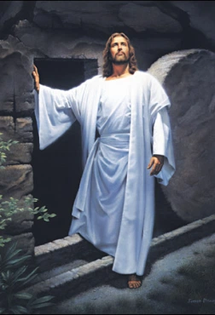
The Resurrection
Lesson 3.4
Ages: 1-5, 6-7, 8-13
TOPIC- EASTER
MARCH 2021 – WASHINGTON REGION LITERATURE COMMITTEE

Slide 2
Objective
In this lesson, the children will learn that Christian faith is centered on the resurrection of Jesus Christ. Children will also discover that God gives believers victory over death and sin through the death and resurrection of His Son, Jesus Christ.

Slide 3
Memory Verse:
Acts 2:32 (NIV)
"God has raised this Jesus to life, and we are all witnesses of it."

Slide 4
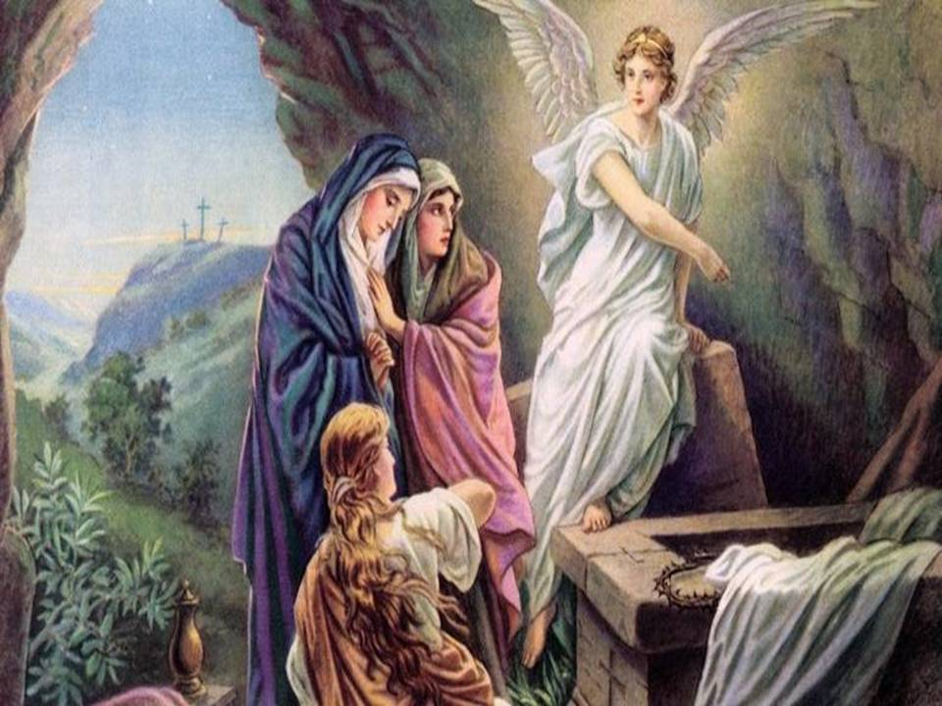
Memory Verse:
Matthew 28:6 (NIV)
He is not here; he has risen, just as He said. Come and see the place where he lay.

Slide 5
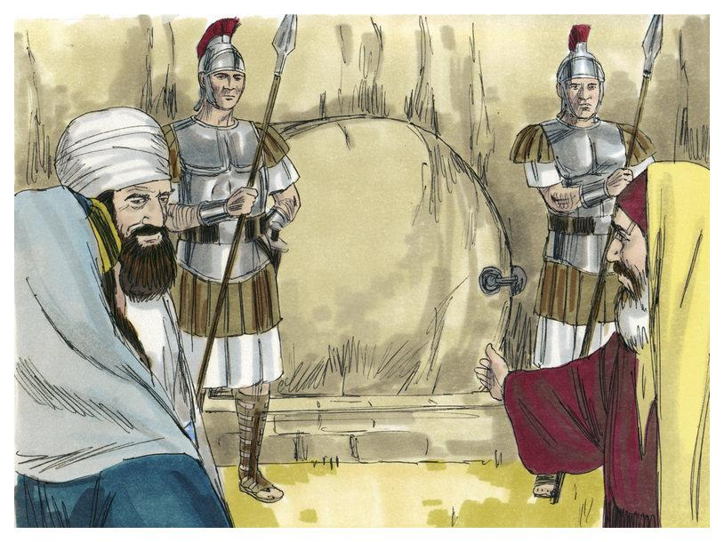

Slide 6
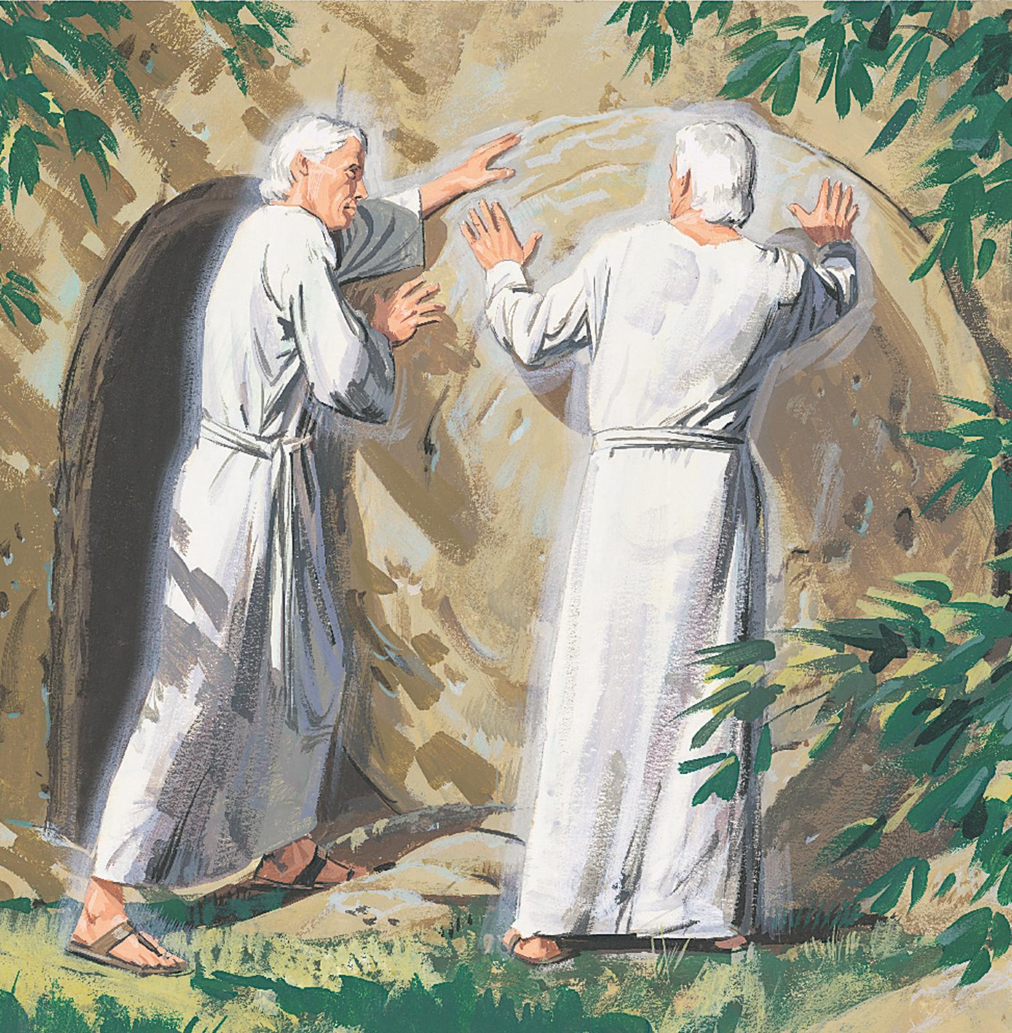

Slide 7
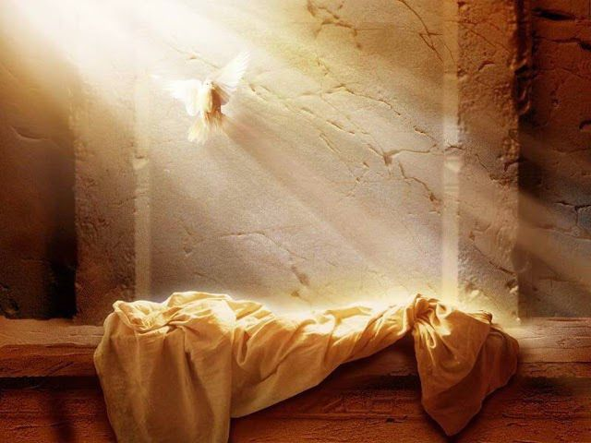

Slide 9
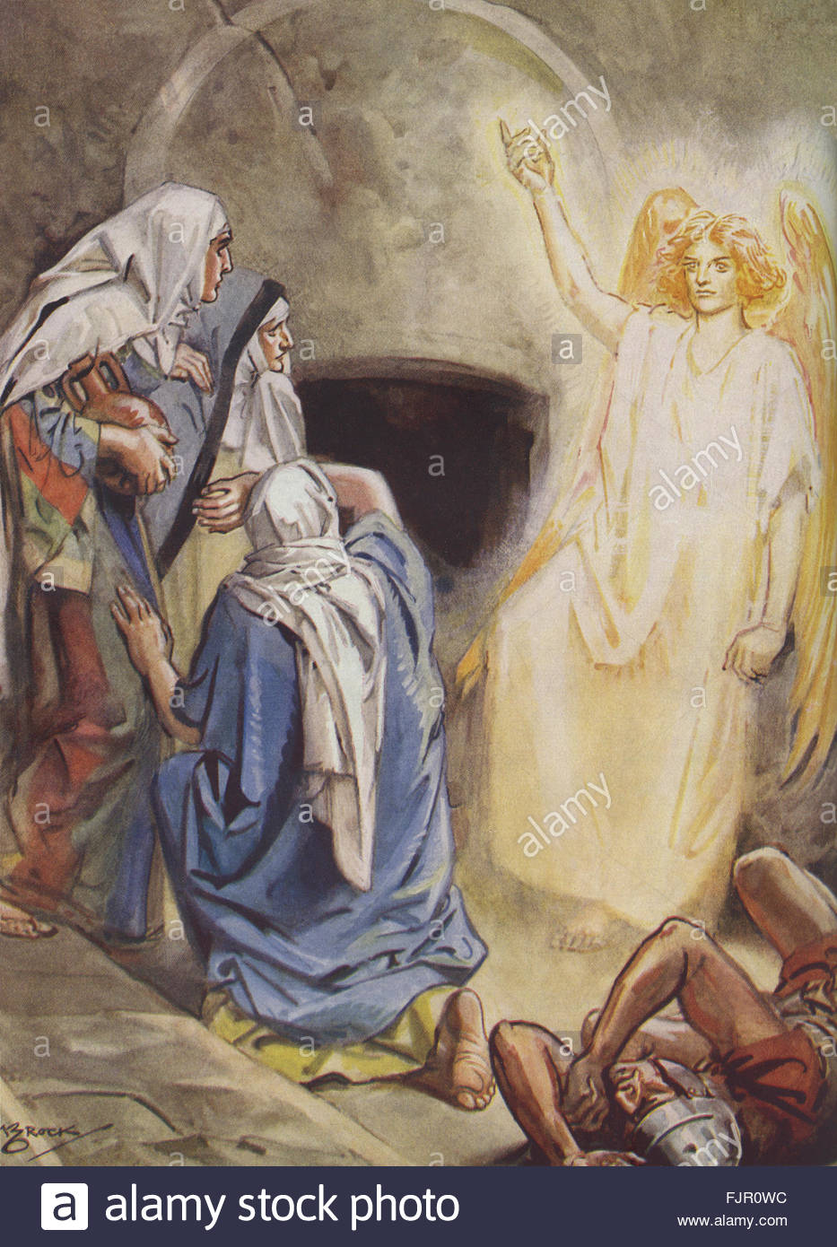

Slide 10
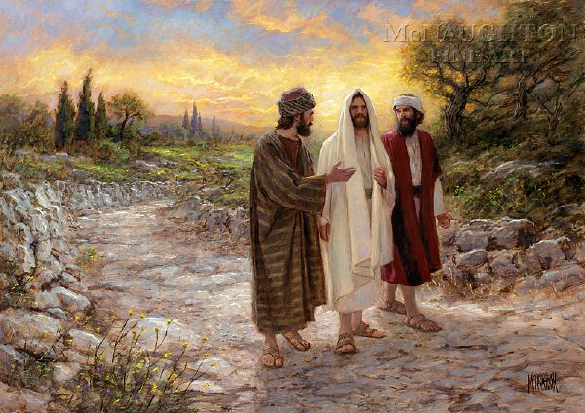

Slide 11
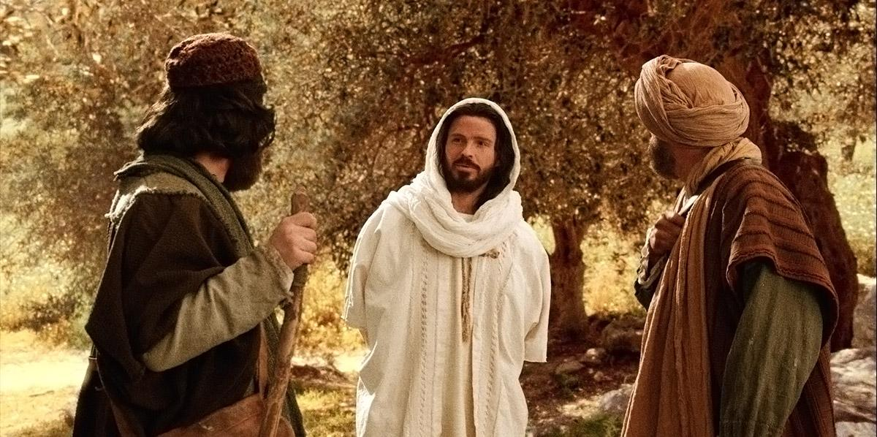

Slide 12
Questions and Discussions
Read Luke 24:1-12
Who were the men in clothes that gleamed like lightning?
What did the angels say to the women?
What did the women do when they returned from the tomb?

Slide 13
Questions and Discussions
Read Luke 24:13-35
Who appeared to two of Jesus' followers while they were on the way to Emmaus?
Were these two able to recognize that it was Jesus walking with them?
When asked, what did these two say they were discussing as they traveled to Emmaus?
When were they able to recognize that Jesus was with them?
What did these two do after Jesus disappeared?

Slide 14
Questions and Discussions
Read Luke 24:36-49
Who appeared to the group of followers while they were discussing what happened on the road to Emmaus?
What did Jesus do to ease their fears and remove their doubt?
Why did Jesus open their minds?

Slide 15
Questions?

Slide 16
Memory Verse:
Acts 2:32 (NIV)
"God has raised this Jesus to life, and we are all witnesses of it."

Slide 17
Memory Verse:
Matthew 28:6 (NIV)
He is not here; he has risen, just as he said. Come and see the place where he lay.

