Slide 1

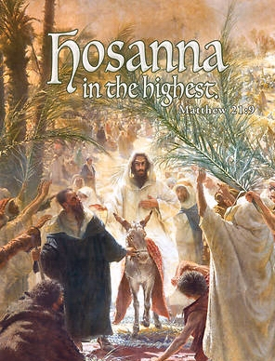
The Triumphal Entry
Lesson 3.1
Ages: 6-7, 8-13
TOPIC- EASTER
MARCH 2021 – WASHINGTON REGION LITERATURE COMMITTEE

Slide 2
Objective
To understand the importance of Humility and Obedience

Slide 3
Memory Verse: (Age group 6-7)
Matthew 21:9b
  “Hosanna to the Son of David!”
  “Blessed is he who comes in the name of the Lord!”
  “Hosanna in the highest heaven!”

Slide 4
Memory Verse: (Age group 8-13)
Matthew 21:9b
  The crowds that went ahead of him and those that followed shouted,
  “Hosanna to the Son of David!”
  “Blessed is he who comes in the name of the Lord!”
  “Hosanna in the highest heaven!”

Slide 5
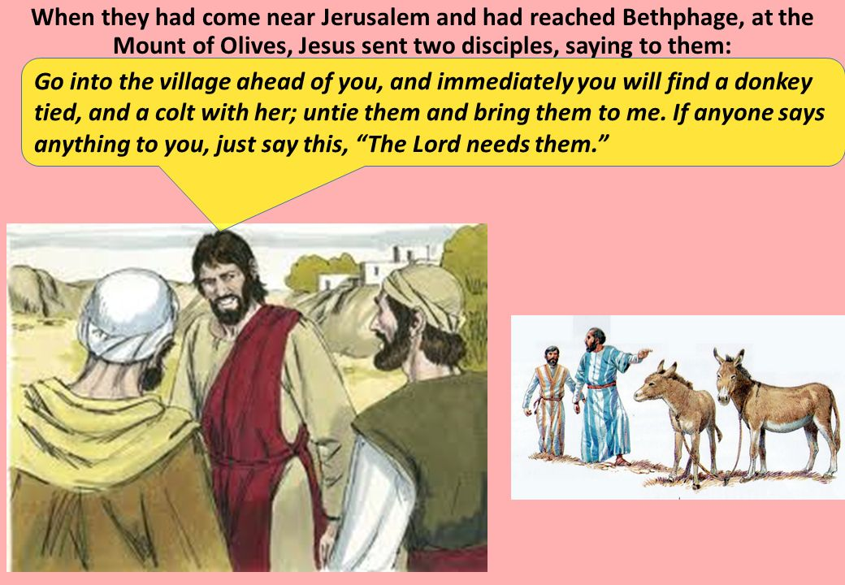

Slide 6
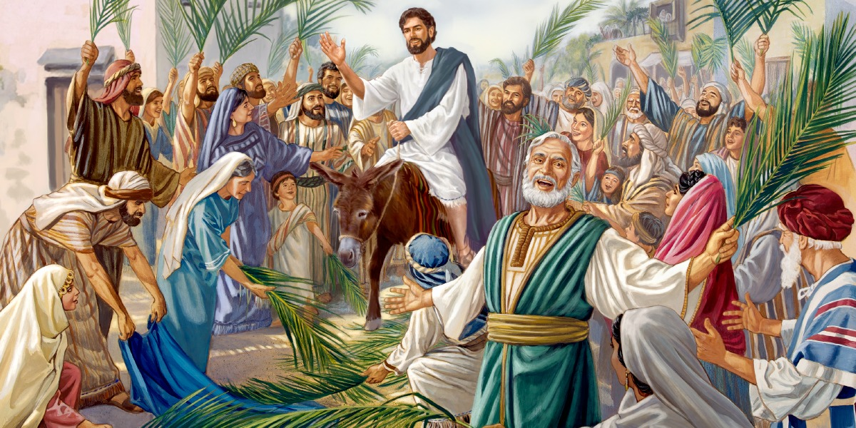
The Passover Celebration

Slide 7
Questions and Discussions
  What did Jesus say his disciples would find in the village?
  How did the disciples prepare the donkey for Jesus?
  What is obedience?
  Demonstrate an act of obedience?

Slide 8
Discussion Questions
  What did the crowd do when Jesus came by?
  How did the people praise God?
  Why do you think Jesus was riding on a donkey? Why not a horse?
  What is humility?
  How can we demonstrate an act of humility?

Slide 9
Questions?

