Slide 1
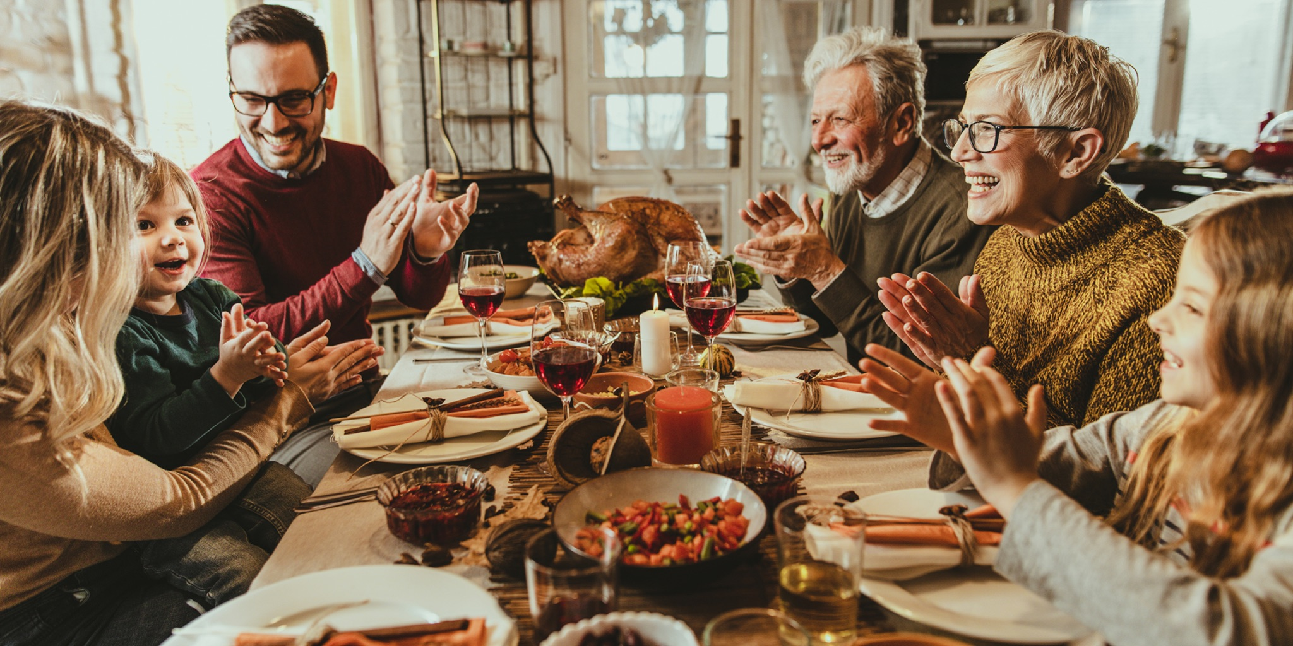
Ages: 1-5 TOPIC- THANKSGIVING
Lesson 5 : Let’s Give Thanks NOVEMBER 2021 – CHILDREN'S MINISTRY LITERATURE COMMITTEE

Slide 2
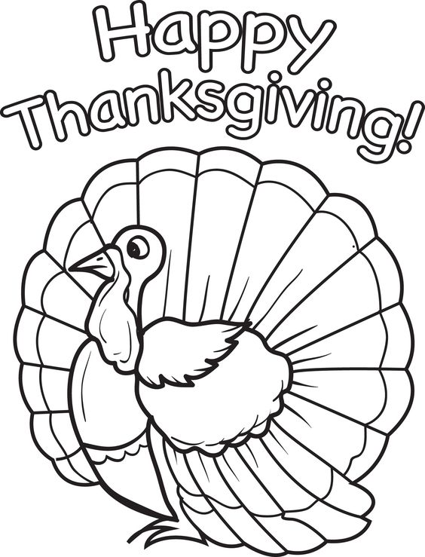
Objective
Children will learn to have a grateful heart by being thankful to God and others.

Slide 3
Scripture Reading: Luke 17:11-19
Jesus sent the ten lepers to the priest. They responded in faith, and Jesus healed them on the way.
Jesus Heals Ten Men with Leprosy but only one returned to “Thank Him”.

Slide 4
Video
Jesus Heals the 10 Lepers
https://www.youtube.com/watch?v=f6Y8dc_fw4o

Slide 5
Discussion Questions
What did we learn in the video?
How many lepers were there?
How many came back to say thank you to Jesus??

Slide 6
Discussion Questions Continues
What are you thankful for?
Why should you say thank you?
What are ways we can give thanks to God?

Slide 7
Answer to Questions
What did we learn in the video? (Jesus heals, be thankful, and have faith in God for all things are possible by Him)
How many lepers were there? (10, ten)
How many came back to say thank you to Jesus? (1, one)
What are you thankful for? (family and friends, God, Jesus dying for my sins, forgiveness, good health, provisions)
Why should we say thank you? (to show gratitude, appreciation, return kindness)
What are some ways we can give thanks to God? (Give thanks in prayer; remember His presence, goodness and love; be obedient and respectful; and serve others or help others)
)

Slide 8
Memory Verse
He threw himself at Jesus’ feet and thanked Him
Luke 17:16 (NIV)

Slide 9
Activities
Song
Let Us Give Thanks - Hand craft

Slide 10
