Slide 1
QUALITIES OF A CHRISTIAN FATHER: INTEGRITY
LESSON 5.4
AGES: 6-7, 8-13
TOPIC- FATHER’S DAY
JUNE 2021 – WASHINGTON REGION LITERATURE COMMITTEE

Slide 2
OBJECTIVE:
To learn the importance of doing what is right even when it is hard to.

Slide 3
GALATIANS 6:9
Let us not become weary in doing good, for at the proper time we will reap a harvest if we do not give up.

Slide 4
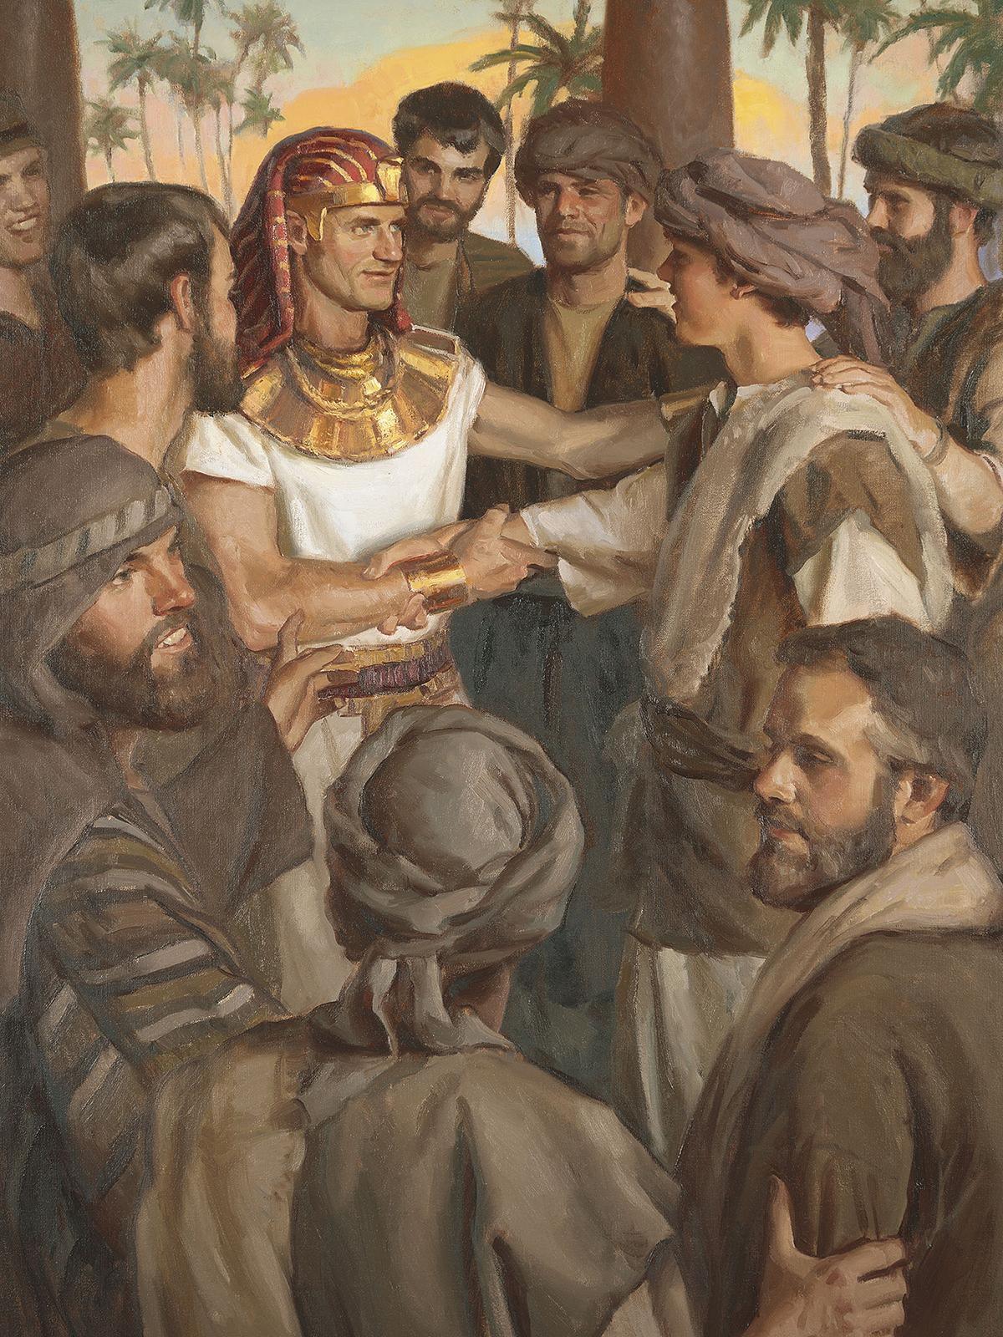

Slide 5
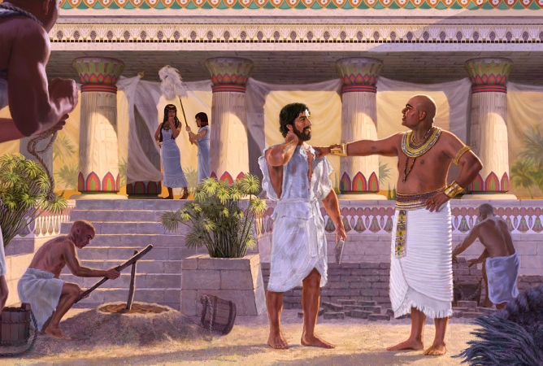
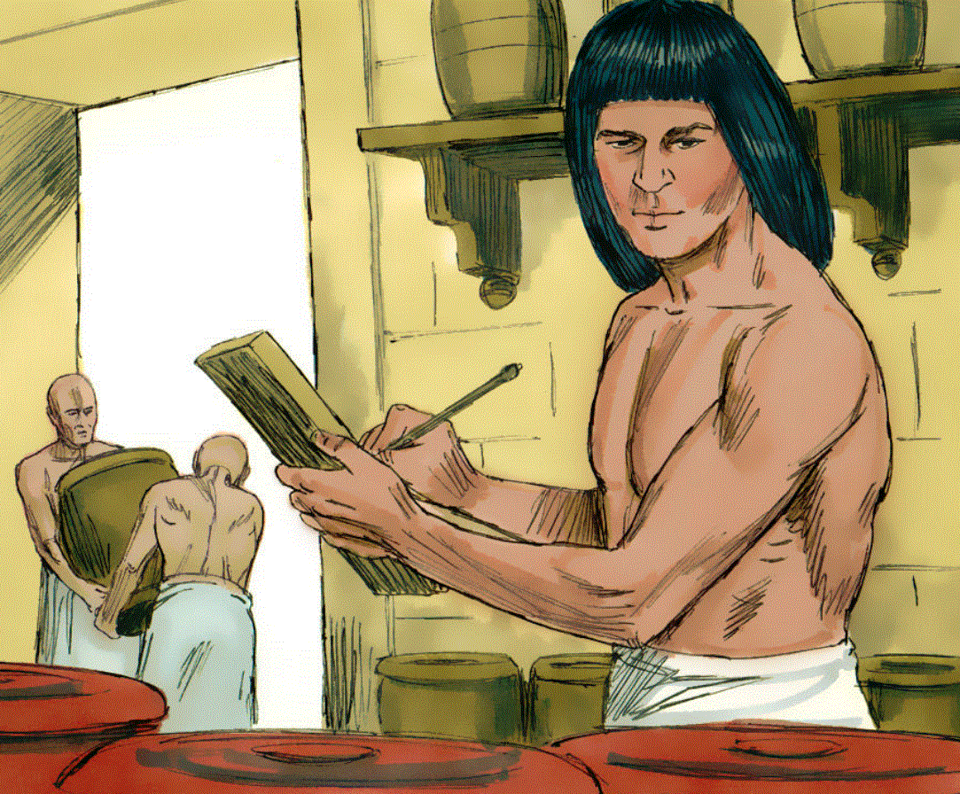
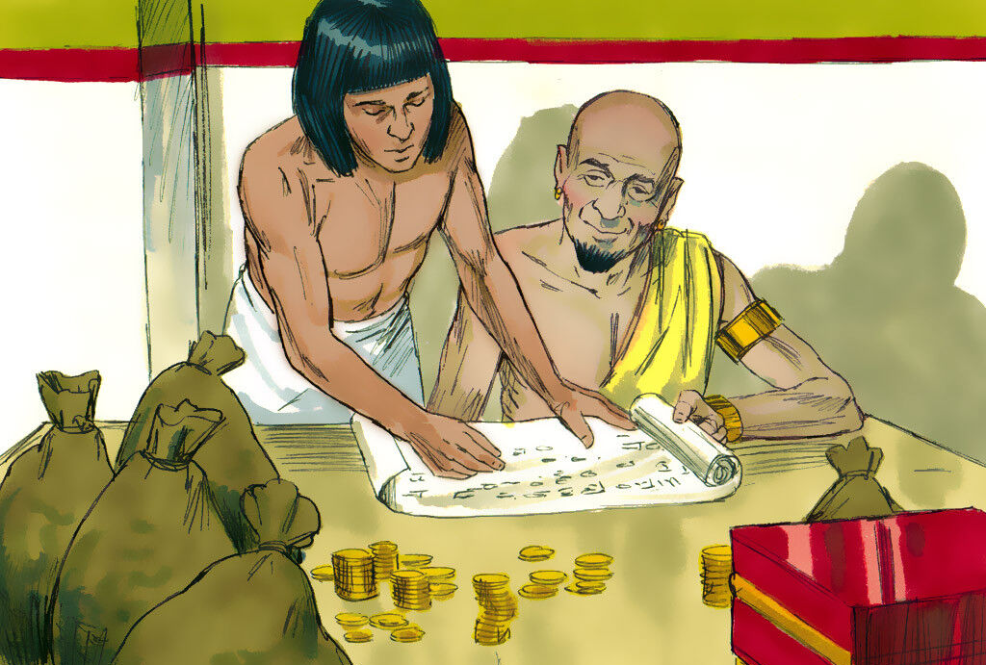

Slide 6
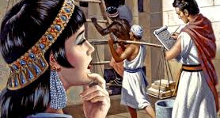
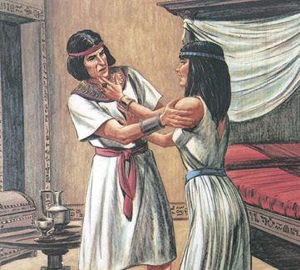
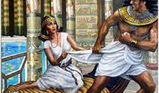

Slide 7
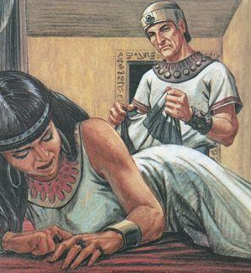

Slide 8
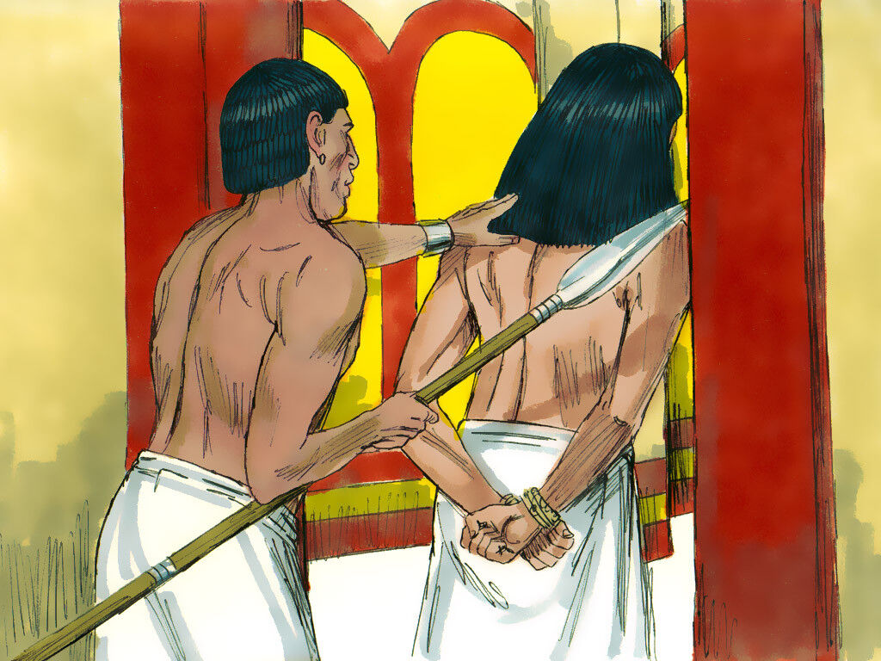
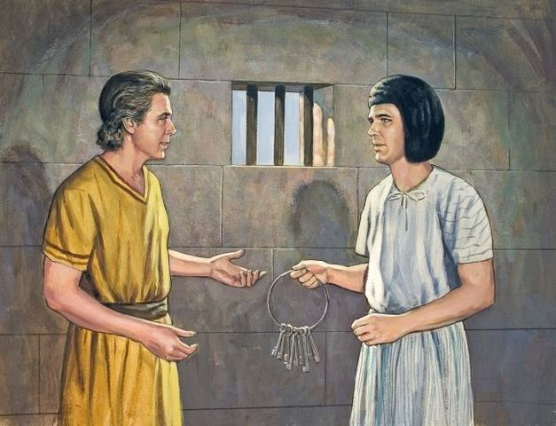

Slide 9
QUESTIONS AND DISCUSSION
Why was Potiphar pleased with Joseph?
Apart from Potiphar, who took notice of Joseph?
What did Potiphar’s wife want from Joseph?
Did Joseph refuse or accept and why?
Did Potiphar’s wife stop after Joseph’s refusal?
How did Potiphar react when his wife accused Joseph of trying to sleep with her?
Did Joseph do the right thing for not sleeping with Potiphar’s wife?
If Joseph did the right thing, did he get the right treatment from Potiphar?
Did God leave Joseph when he was in prison? What happened?

Slide 10
QUESTIONS

